Slide 1
1281 MLR Template
User Guide
Youngrak Park (DE TCE-A), Woo Seok Kim (DE TCE-B)
Last Updated - 07/14/2026

Slide 2
Description
This template is based on a FET-like front-end (FE) structure and is primarily intended for capacitance (CAP) measurement.
A parameterized unit cell is defined and replicated into an array, allowing users to add, modify, or remove FE-related shapes to control parasitic and device capacitance characteristics.
M0 layer is used to connect to front-end shapes, which are then routed through M1 jumper layers to corresponding pins and pads for CAP measurement.

Slide 3
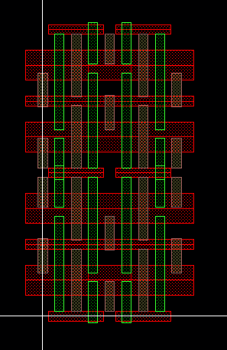
Track Indexing Scheme
0 1 2 3
All layout placement in this template is based on track-level indexing.
Each layer has its own track set indexed starting from 0.
Indexing Direction
  OGD direction: Left → Right
  PGD direction: Bottom → Top
Reverse Indexing
  A track can be referenced from the opposite edge using the r suffix.
  r0 always refers to the last available track on that layer.
  Example: for 5 tracks indexed 0–4:
    r0 → track 4
8
7
6
5
4
3
2
1
0
0 1 2 3 4
r4 r3 r2 r1 r0

Slide 4
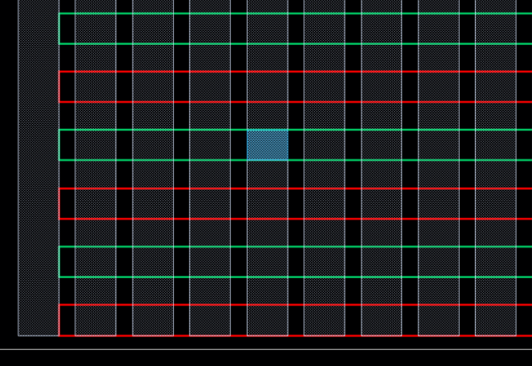
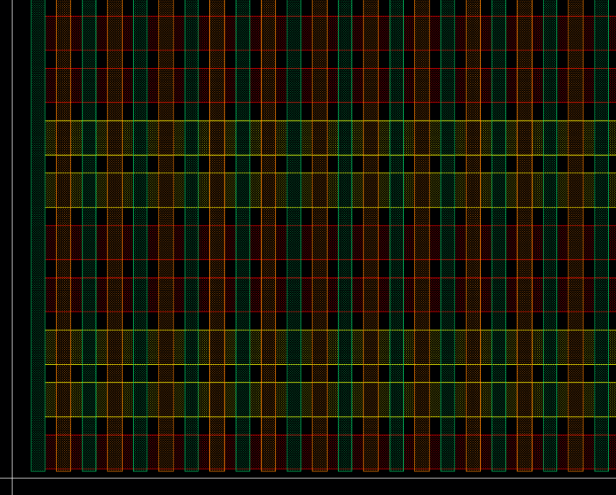
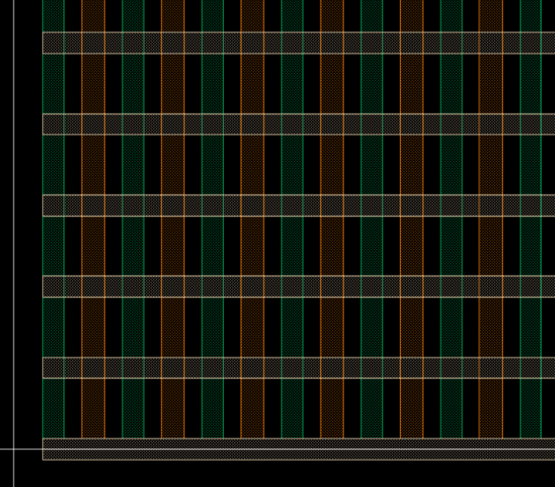
Track Indexing Reference
m0 cut guide
0
1
2
3
4
5
6
7
M0; tccGuide1
m0 tracks
4
0
1
2
3
4
5
6
7
8
9
10
0
1
2
3
4
5
6
7
8
9
10
11
3
M0; tccGuide2
m0 cut guide
7
m0 tracks
2
6
1
0
5
4
0
1
2
3
4
5
Poly; tccGuide1
0
1
2
3
4
5
6
3
Tcn; tccGuide1
4
Poly/Tcn; tccGuide2
2
3
1
2
0
1
Poly; tccGuide1
Ndiff; tccGuide1
Tcn; tccGuide1
Pdiff; tccGuide1
0

Slide 5
Index Pattern Definition
Index patterns are used to specify track locations for all unit cell inputs. Below is supported syntax.
  x → single track index
    Example: 5 (track 6th line from the bottom or left)
  x:y → Inclusive range of tracks
    Example: 5:10 → indices 5 through 10
  x:y[z] → Range with step (skip z tracks between occurrences)
    Example: 5:10[1] → indices 5, 7, 9 (6th, 8th, 10th physical tracks)
  x1/x2/x3 → Explicit list of track indices
    Example: 1/3/6 → indices 1, 3, 6
  Multiple patterns → Separate entries using ;
  Reverse indexing may used within any pattern by applying the r suffix.
    Example: r0 → always refers to the last available track on the specified layer.

Slide 6
Structure Zones
Castle
Buffer
Unit Cell 1.2
Unit Cell 2.2
Unit Cell 1.1
Unit Cell 2.1

Slide 7
Routing Construction
Jumpers
Pin1
Vcx Shapes
Pin4
Pin2
Pin3

Slide 8
INPUT PARAMETERS

Slide 9
Unit Cell and Array Setup
CellHeight (string) → Cell height of the structure
  Legal Values: ch110, ch132, ch165
  Example: “ch110”
PolyPitch (string) → Poly pitch of the structure
  Legal Values: pp44
  Example: “pp44”
UnitCellSizeOgd/UnitCellSizePgd (int) → Number of poly pitches or cell heights in each unit cell
  Example: 10
ArraySizeOgd/ArraySizePgd (int) → Number of arrays in the OGD/PGD direction.
  Example: 2
BufferSizeL/BufferSizeR/BufferSizeB/BufferSizeT (int) → Size of any FE buffer between the unit cell array and castle in every direction. In units of poly pitches or cell heights.
  Example: 2

Slide 10
Unit Cell Inputs
Pattern Definitions:
  Unit-level inputs define patterns inside the unit cell.
  Defined patterns are replicated identically across the unit cell array.
  Inputs override global patterns where defined.
  Undefined regions inherit default behavior
DiffPatternUnit (string) → Define the diffusion and devflav pattern
  Note: Any space on diffusion tracks that is left undefined by this input will extend the outermost unit cell diffusion type to the edge of the buffer
  Format: x-pattern, y-pattern, width (0 indicates no diffusion and default indicates min diffusion width), devflav (optional when width of 0);
  Example: 0:10,0/3,0.03,plvt; 0:5,0:8[3],0,anystringbecausewidthiszero
VcxPatternUnit (string) → Define vg/vt shapes (All input format for skew are optional. )
  Format: via layer,poly/tcn track,m0 track,via width ogd (optional), via width pgd (optional)|cd skew X, cd skew Y, reg skew X, reg skew Y$<net name>(optional)
  Example: vt,3:5/8:10/13:15/18:20,0/7;vg,1,1|0.004,0,0,0
PolyPlugsUnit (string) → Define poly plugs
  Format: poly tracks, poly cut guide tracks;
  Example: 0/1/5/6,0:4;

Slide 11
Unit Cell Inputs (cont.)
TcnPlugsUnit (string) → Define tcn plugs
  Format: tcn tracks, tcn cut guide tracks;
  Example: 0/1/5/6,0:4;
TcnDepopUnit (string) → Define tcn depop selection
  Format: tcn track, diffusion track;
  Example: 0/1/5/6,0:4;
VcrPatternUnit (string) → Define vcr shapes (All input format for skew are optional. )
  Format: tcn track, m0 (power) track|cd skew X, cd skew Y, reg skew X, reg skew;
  Example: 2:6,2;0:3,1;6:11,3:4|0,0.002,0,0;
VcrnubPatternUnit (string) → Define vcrnub shapes (All input format for skew are optional. )
  Format: poly track,m0 (power) track, nub direction (top, bottom, or both) |cd skew X, cd skew Y, reg skew X, reg skew;
  Example: 3:5,2,top;2,1,bottom;7:10,3:4,both|0,0.005,0,0;
TcnExtensionUnit (string) → To extend specific tcns which are facing the vcrnub
  Note: To be called ONLY after the tcn and vcrnub shapes are finalized. Converting them is not necessary before the function call.
  Format: tcn track, m0 (power) track;
  Example: 3:5,2;2,1;8:4;
M0CutPatternUnit (string) → Define m0 cuts. This depends on cd; space; in M0CutLegoPattern (slide #15).
  Format: m0 cut guide tracks , m0 tracks;
  Example: 0/1/5/6,0:4;
FtiTracksUnit (string) → Define fti shapes
  Format: poly tracks, diff tracks;
  Example: 0/1/5/6,0:4;

Slide 12
Global Inputs
Pattern Setup:
  Global inputs apply outside unit cell regions
  Used primarily for buffer area
  Ignored whenever unit cell inputs are defined
  Using negative indexing is helpful when defining global inputs. By adding negative indexing to the end of track ranges, patterns may not have to change when increasing size of structures.
  The intention will be to have the buffer area around unit cells to be DRC clean by using default values in these global inputs.
DiffPatternGlobal (string) → Define the diffusion and devflav pattern
  Format: x-pattern, y-pattern, width (0 indicates no diffusion and default indicates min diffusion width), devflav (optional when width of 0);
  Example: 0:10,0/3,0.03,plvt; 0:5,0:8[3],0,anystringbecausewidthiszero
VcxPatternGlobal (string) → Define vg/vt shapes (All input format for skew are optional. )
  Format: via layer,poly/tcn track,m0 track,via width ogd (optional), via width pgd (optional)|cd skew X, cd skew Y, reg skew X, reg skew Y$<net name>(optional)
  Example: vt,3:5/8:10/13:15/18:20,0/7;vg,1,1|0.004,0,0,0;
PolyPlugsGlobal (string) → Define poly plugs
  Format: poly tracks, poly cut guide tracks;
  Example: 0/1/5/6,0:4;

Slide 13
Global Inputs (cont.)
TcnPlugsGlobal (string) → Define tcn plugs
  Format: tcn tracks, tcn cut guide tracks;
  Example: 0/1/5/6,0:4;
TcnDepopGlobal (string) → Define tcn depop selection
  Format: tcn track, diffusion track;
  Example: 0/1/5/6,0:4; VcrPatternGlobal (string) → Define vcr shapes (All input format for skew are optional. )
  Format: tcn track, m0 (power) track|cd skew X, cd skew Y, reg skew X, reg skew;
  Example: 2:6,2;0:3,1;6:11,3:4|0,0.002,0,0;
VcrnubPatternGlobal (string) → Define vcrnub shapes (All input format for skew are optional. )
  Format: poly track,m0 (power) track, nub direction (top, bottom, or both)|cd skew X, cd skew Y, reg skew X, reg skew;
  Example: 3:5,2,top;2,1,bottom;7:10,3:4,both|0,0,0,0.004;
TcnExtensionGlobal (string) → To extend specific tcns which are facing the vcrnub
  Note: To be called ONLY after the tcn and vcrnub shapes are finalized. Converting them is not necessary before the function call.
  Format: tcn track, m0 (power) track;
  Example: 3:5,2;2,1;8,4;
M0CutPatternGlobal (string) → Define m0 cuts
  Format: m0 cut guide tracks, m0 tracks;
  Example: 0/1/5/6,0:4;
FtiTracksGlobal (string) → Define fti shapes
  Format: poly tracks, diff tracks;
  Example: 0/1/5/6,0:4;

Slide 14
Metal Lego Pattern Definition:
M0LegoPattern (string) → M0 Lego Pattern Definition
  In x81rb, only fixed cd;spc; allowed by SDR are permitted, so the Lego pattern does not operate arbitrarily. Updates are planned for the future (x81z or x81a).
  Leaving it blank draws the default lego pattern for the specified cellHeight
  Format: cd;spc;cd;spc…
  Example: 0.017;0.009;0.012;0.009;0.012;0.009;0.012;0.009;0.012;0.009;
  Guides drawn can be seen using m0;tccGuide1
M0CutLegoPattern (string) → M0 Cut Lego Pattern Definition
  This Lego pattern serves as the cut guides for M0 (visible using m0;tccGuide2) that determine where M0 cuts are placed.
  Leaving this blank draws the default cut lego pattern for the specified cellHeight.
  Format: cd;spc;cd;spc…
  The actual cuts are applied through the M0CutPatternUnit/M0CutPatternGlobal parameters.

Slide 15
Active M0 Track Selection:
DFActiveTracks (string)
SFActiveTracks (string)
GFActiveTracks (string)
TAP2ActiveTracks (string)
TAPActiveTracks (string)
  → Specifies which M0 tracks connect to routing jumpers
  Note: Layer is determined by parsing the pin inputs on the next slide.
  Format: trackPattern
  Example: 2 (or) 0;4;7 (or) 1:8[3]

Slide 16
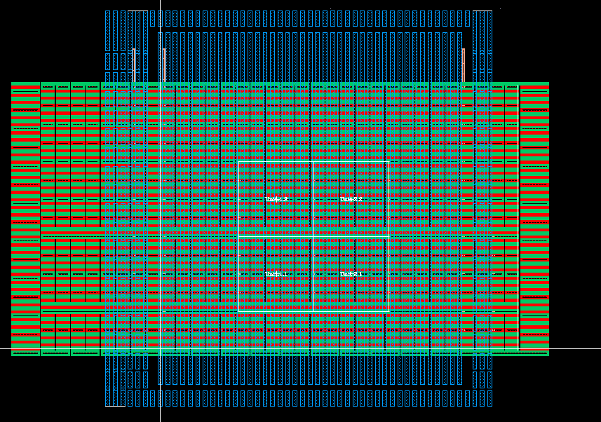
Pin Setup
DF/SF/GF/TAP2/TAPData (string)
  Defines routing from FE through M0 and M1 to pins
  Track Layer: A Layer which are used from the structure to jumper (bus) layer or Pin directly
  Bus Layer: A Layer to bus from the track layer to Pin
  Jumper Side: L/R/T/B for jumper location or A (Active Lay) to directly connect to Pin
  Track Range: In units of jumper tracks, width of pin
  Pin Position: L/R/T/B for routing pin location on left, right, top, or bottom of the structure
  Format: TrackLay, BusLay, Jumper Side(L/R/T/B/A), Track Range, PinPos(L/R/T/B)
  Example: m0,m0,A,r0:0,R → m0 bussing using the active track
  m0,m1,R,0:2,T → m1 bussing using jumper on the right side (at Castle region)
PIN
PIN
Example1 (M0 bus)
Example2 (M1 bus)

Slide 17
Miscellaneous:
DrawMiscIDsUnit (string) → Desired boxes can be drawn within the unit cell by utilizing layer and purpose from valid LPPs.
  Format: layer, purpose, polyRange, diffRange, growLeft, growRight, growTop, growBottom
  All formats for grows are optional but require all 4-side values when user wants to apply it.
  polyRange and diffRange can be either startRange : endRange (or) trackNumber ([ ] is not available)
  LPPs are case-sensitive. Multiple LPPs can be separated by a semi-colon
DrawMiscIDsGlobal (string) → Desired boxes can be drawn within the buffer by utilizing layer and purpose from valid LPPs.
  Format: layer, purpose, polyRange, diffRange, growLeft, growRight, growTop, growBottom | repeat_X, repeat_Y, Dist_X, Dist_Y
  All formats for grows and repeats are optional but require all 4-side values when user wants to apply it.
  polyRange and diffRange can be either startRange : endRange (or) trackNumber (/, [ ] are not available)
  LPPs are case-sensitive. Multiple LPPs can be separated by a semi-colon
  Example: epiblock,id,3:5,6:6|20,1,0.012,0 (It will draw 20 boxes in a row (6), with 12nm distance)
DeleteLpps (string) → Delete specified LPPs from the structure
  Format: layer1:purpose1; layer2:purpose2
  LPPs are case-sensitive. Multiple LPPs can be separated by ;

Slide 18
TSDR Skews:
PolyCdSkew (string) → Poly CD for Poly Pitch/CD Skews.
  Pitch is determined from the PolyPitch parameter.
  Format: Example: floating point value for poly CD
FTICdMisregSkew (string) → FTI CD and Misreg Skew
  Format: FTIGrow_Ogd,FTIGrow_Pgd,FTI,Misreg_Ogd,FTIMisreg_Pgd,Draw_NoDepop
  Example: 0,0.0035, 0,0,Y (or) 0,0,-0.006,0,Y (or) 0,0,0,0,N
  TSDRNoDepop drawn can be seen using fti;TSDRNoDepop
TCNCdSkew (string) → TCN CD for Poly Pitch/CD Skews.
  Pitch is determined from the PolyPitch parameter.
  Format: Example: floating point value for poly CD
SFTSkew (string) → Forksheet Skew
  Format: DprCd,FlcCd,SpineCd, Y or N to replace FLC_mask with PXL_mask
  Spine will not be drawn as a physical layer (We need it for determining the space between DPR_mask)
  The rest of the masks (PXL, GLK, TLK) will be automatically drawn
TallCellSkew (string) → TallCell Skew
  Format: dprCd,wideDprCd [CD for Regular DPR_mask and Wide DPR_mask]
  The rest of the masks (PXL, GLK, TLK) will be automatically drawn
update needed

Slide 19
TSDR Skews:
DPRSkew (string) → DPR CD and Misreg Skew
  Format: DprCd,DprMisreg
PXLSkew (string) → PXL CD and Misreg Skew
  Format: PxlCd,PxlMisreg,DprCd [CD for PXL_mask, Misreg value for PXL_mask and CD for FLC_mask]
  The rest of the masks (GLK, TLK) will be automatically drawn
IdLayerBasedSkew (string) → PXL CD and Misreg Skew
  Format: PxlCd,PxlMisreg,DprCd [CD for PXL_mask, Misreg value for PXL_mask and CD for FLC_mask]
  The rest of the masks (GLK, TLK) will be automatically drawn
GLKSkew (string) → GLK CD and Misreg Skew
  Skews Poly plugs
  Format: GLKGrow_Ogd,GLKGrow_Pgd,GLKMisreg_Ogd,GLKMisreg_Pgd
TLKSkew (string) → TLK CD and Misreg Skew
  Skews Tcn plugs
  Format: TLKGrow_Ogd,TLKGrow_Pgd,TLKMisreg_Ogd,TLKMisreg_Pgd
update needed

